Slide 1

Vascular Surgery Series
Course 1 Part 1
Peripheral Vascular Disease
Michelle R. Tinkham
RN,BSN,MS,CNOR,CLNC,RNFA

Slide 2
Objectives:
Define Peripheral Vascular (PVD) and Peripheral Artery Disease (PAD)
Identify Signs/Symptoms of PAD
Discuss risk factors for Peripheral Vascular Disease
Identity possible treatments with examples of each

Slide 3
Peripheral Vascular Disease
Overview of Disease

Slide 4
Peripheral Vascular Disease
What is Peripheral Vascular Disease?
  This is a condition where blood vessels in the body (other than the heart and brain) are constricted and circulation is impaired.
Notes:
Heart= coronary artery disease Brain= Cerebral artery disease

Slide 5
Peripheral Vascular Disease
When this constriction affects the arteries, it is called Peripheral Artery Disease (PAD).
This is similar to Coronary Artery Disease (CAD) which affects the arteries of the heart.

Slide 6
Peripheral Vascular Disease
What causes this disease?

Slide 7
Peripheral Vascular Disease
Many conditions can lead to Peripheral Vascular Disease:
  Atherosclerosis: build-up of fatty plaque on the insides of the larger blood vessels
  Other situations which cause the vessels to spasm: Raynaud’s Disease, smoking, cold weather, stress
Notes:
arteriosclerosis is plaque in the smaller vessels

Slide 8
Peripheral Vascular Disease
Atherosclerosis can take many years to cause symptoms.
Not only does it impair circulation, the plaque can break off and block circulation all together
Notes:
When the plaque breaks off, collateral circulation takes over. If it is not enough then the limb becomes ischemic and can die.

Slide 9
Peripheral Vascular Disease
This blockage can cause strokes, renal failure, loss of limb, etc depending on where the blockage is and how severe

Slide 10
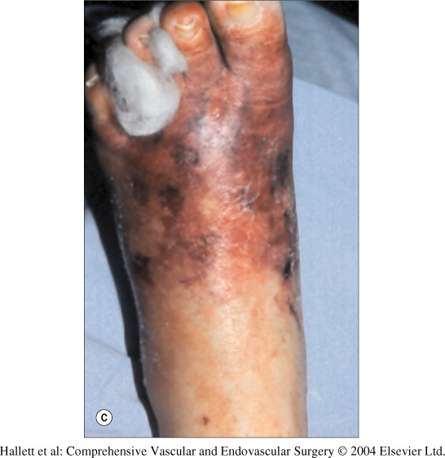
Necrotic tissue after occlusion to foot
When the blood vessels become obstructed, the tissues do not receive the necessary circulation to thrive. Over time, the area may become necrotic and if flow cannot be re-established, an amputation may have to be performed.

Slide 11
Peripheral Vascular Disease
What causes Atherosclerosis?

Slide 12
Peripheral Vascular Disease
Many factors can contribute to Atherosclerosis:
Smoking
High Cholesterol
Diabetes
Hypertension
Obesity and inactivity
Notes:
Some of these factors can’t be changed, but many can be improved with lifestyle modification.

Slide 13
Peripheral Vascular Disease
Many people who have PAD due to fatty deposits in their peripheral arteries, often also have CAD in his/her heart.
This greatly increases the risk for heart attack and stroke

Slide 14
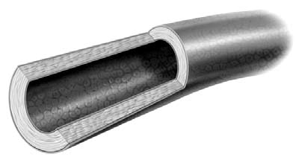
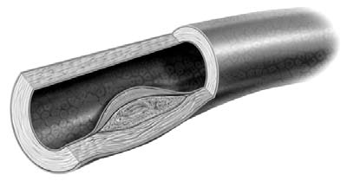
Peripheral Vascular Disease
Normal Blood Vessel
Vessel with plaque
Notes:
Diagram on the left shows a normal vessel. The vessel on the right has plaque. See how the plaque builds up and makes the lumen of the vessel smaller. This continues to build until the vessel is blocked.

Slide 15
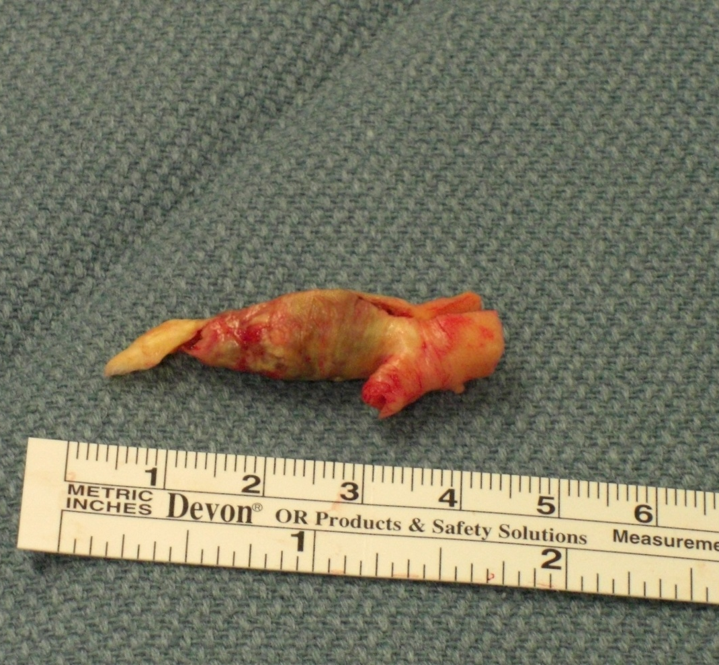
Plaque from a Carotid Artery
Removed during a Carotid Endarectomy

Slide 16
Peripheral Vascular Disease
What are the signs and symptoms of Peripheral Vascular Disease?

Slide 17
Peripheral Vascular Disease
Some people have no symptoms (asymptomatic)
  According to the American Heart Association 75% of people with PAD have no symptoms
  Women are less likely to have symptoms than men

Slide 18
Peripheral Vascular Disease
  Symptoms:
Some patients have fatigue, especially in their legs
Others complain of extreme pain and cramping referred to as “intermittent claudication” (IC).
Notes:
IC can be in the legs and buttocks.

Slide 19
Peripheral Vascular Disease
Intermittent Claudication is a painful condition characterized by cramping and fatigue of the lower extremities and buttocks whenever the patient is active but dissipates at rest.
            American Heart Association

Slide 20
Peripheral Vascular Disease
What tests can detect PAD if you have no symptoms?

Slide 21
Peripheral Vascular Disease
  Tests:
Physical Exam
Personal Medical History
Family Medical History
Lab tests
Ultrasound
CT Angiography
Magnetic Resonance Angiography
Notes:
Cholesterol level, blood pressure. The last three are more diagnostic after a possible problem is discovered.

Slide 22
Peripheral Vascular Disease
During the physical exam, the doctor may perform an Ankle Brachial Test (ABI)
  This test measures the blood pressure in the ankle and arm at rest and then after 5 minutes of mild exercise.
  If the pressure decreases after exercise it is an indication you may have PAD
Notes:
Mild exercise = treadmill. If the pressure decreases with exercise, it is a sign that blood isn’t circulating properly in the legs.

Slide 23
Peripheral Vascular Disease
Normal ABI: 1 or 1:1
Abnormal: less than 1
  Intermittent Claudication: <0.8
  Threat of loss of limb: 0.25 or below

Slide 24
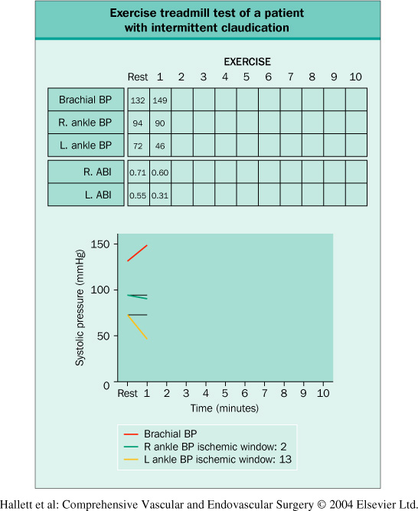
Peripheral Vascular Disease

Slide 25
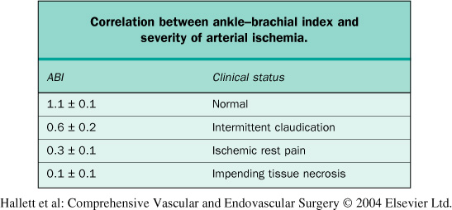
Peripheral Vascular Disease

Slide 26
Peripheral Vascular Disease
Personal/Family History:
  Age
  Gender
  Diet high in fat, low in fiber
  Sedentary or infrequent exercise
  Smoking
  Self or Family History of:
    Diabetes
    Hyperlipidemia
    Hypertension
Notes:
Older, male= more prone

Slide 27
Peripheral Vascular Disease
Prevalence does increase with age
Direct correlation between diet and exercise and development of Atherosclerosis
4 fold increase in PAD incidence in smokers
Studies show increased risk of heart disease with a positive family history

Slide 28
Peripheral Vascular Disease
  Risk factors (cont):
  Diabetes: the chance of a diabetic needing an amputation increases 10x if they also have PAD
  Multiple risk factors greatly increase the incidence of PAD and further complications

Slide 29
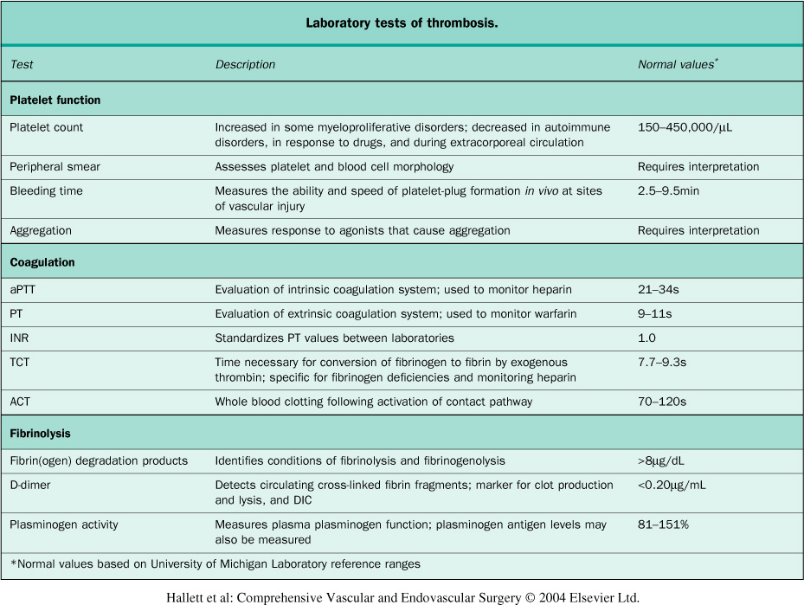
Perip
If symptoms or test results warrant more testing, several other scans such as Doppler studies, CT scans, ultrasounds, MRA or more invasive studies such as angiograms can be performed.
Notes:
Some of the lab tests that can be done to detect plaque formation. PT/PTT is the most common.

Slide 30
Peripheral Vascular Disease
If symptoms or test results warrant additional testing, a variety of scans are available; both non-invasive and invasive.

Slide 31
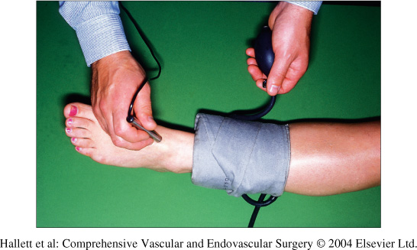
Continuous-Wave Doppler Measurement
Assesses for intermittent claudication

Slide 32
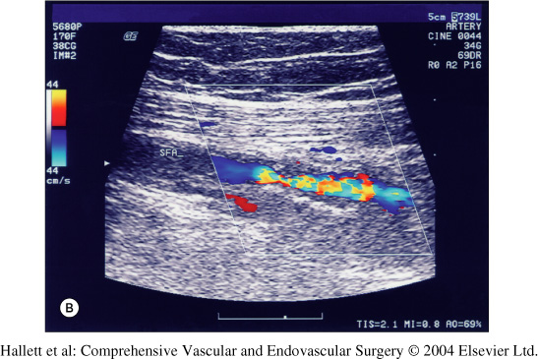
Duplex Ultrasound
Shows blood flow based on color. Higher pressure blood flow is indicated by a change in color: blue to orange
Notes:
You can see where the vessel is constricted, blood flow pressure is higher.

Slide 33
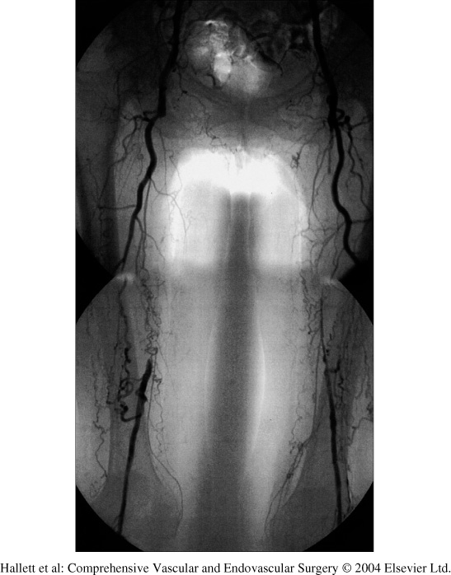
Angiogram
A more invasive test where dye is injected in the vessels under fluoroscopy to show occlusion
This patient has multiple bilateral femoral occlusions

Slide 34
Peripheral Vascular Disease
Treatments

Slide 35
Peripheral Vascular Disease
What treatments are available if you have Peripheral Vascular Disease?

Slide 36
Peripheral Vascular Disease
Treatments:
  Lifestyle Changes:
    Stop Smoking
      Smokers show symptoms 10 years earlier than non-smoker
    Exercise consistently
    Eat a low fat, high fiber diet

Slide 37
Peripheral Vascular Disease
Some risk factors cannot be prevented and sometimes lifestyle changes alone are not enough.
You may also need medications especially if you have diabetes, hypertension, and/or hyperlipidemia to get these conditions under control

Slide 38
Peripheral Vascular Disease
Medications:
Statins to lower cholesterol
  Such as Lipitor
Antiplatelet agents to prevent clots
  Such as Coumadin
Blood pressure medications
  Such as Lotensin
Glucose control
  Such as Insulin

Slide 39
Peripheral Vascular Disease
Sometimes the condition is so severe that lifestyle changes and medications alone will not provide relief.
In these cases, more invasive treatments are necessary
  Endovascular Treatments
  Surgical Interventions

Slide 40
Peripheral Vascular Disease
Endovascular Treatments
Surgical Interventions
Angioplasty
Stenting
Endararectomy
Bypass
  With in-situ or synthetic graft placement

Slide 41
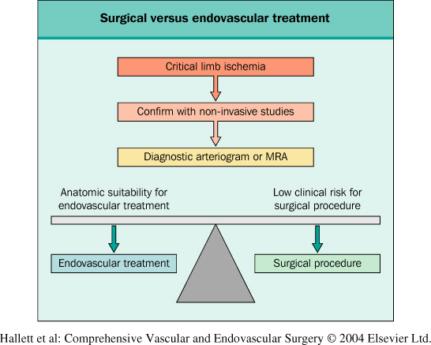
How do you decide? Endovascular vs. Surgery
Often the severity of symptoms and the overall risk to the patient will dictate what approach is used.
It is very important to choose patients appropriately.
Keep in mind: Some patients because of other comorbidities may not tolerate anesthesia.
Some endovascular procedures require lifelong CT follow-up.
Notes:
Patient selection plays a big role in endovascular procedures. Their anatomy, and their compliance vs. the risk of surgery decides.

Slide 42
Peripheral Vascular Disease
Endovascular Procedures
Surgical Interventions
Less Invasive
Quicker recovery
Risk of rupture
Risk of emboli due to debris being loosened
Risk of re-stenosis
Often need for additional interventions
Often better patency of vessels after procedure
Longer hospital stay and recovery time
Anesthetic risks

Slide 43
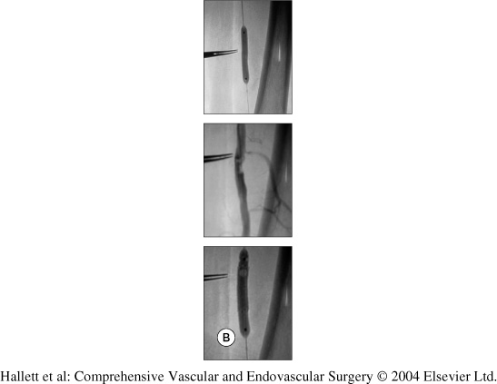
Percutaneous Transluminal Angioplasty
The most widely used endovascular procedure is the balloon angioplasty or PTCA sometimes followed by stent placement.
Angioplasty is normally performed in the Angio or Cath Lab departments by either an Interventional Radiologist, or Cardiologist.
This picture shows an area treated with PTCA
Notes:
The first picture shows the balloon being placed. In the second you can see the constricted areas and finally in the last picture you can see the balloon being inflated and the stenotic areas opened.

Slide 44
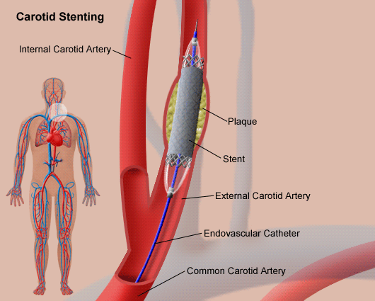
Stenting
In some cases, balloon angioplasty is not enough to keep the vessel open and a stent may be placed.
Common classifications of stents are: bare, drug-eluting, and covered.
The chart to the right depicts a carotid stent placement.
Notes:
The stent stays in place and in theory keeps the vessel from re-occluding

Slide 45
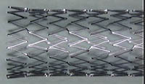
SMART Nitinol stent
This is an example of a bare stent. Nitinol is a nickel-titanium stent and is the preferred stent after failed angioplasty

Slide 46
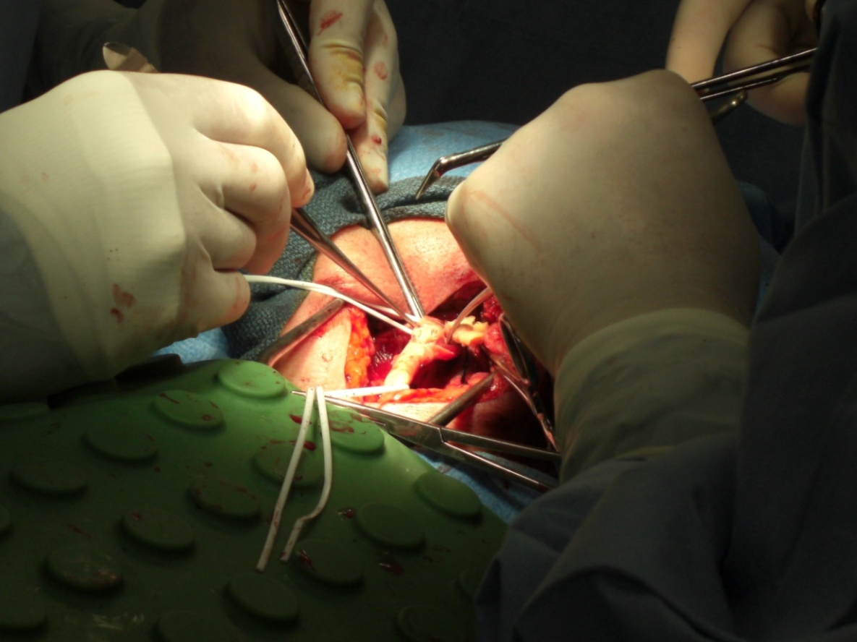
Surgical Interventions
For some patients, surgery is the best option for salvaging the vessel.
The rest of this series will be focused on these surgical options based on the location of the occlusion: carotid, femoral, iliac and aortic.

Slide 47
References
American Heart Association.
Website: www.americanheartassociation.org
Creager MA, Libby P (2004). Peripheral arterial diseases. In DP Zipes et al., eds., Braunwald's Heart Disease, 7th ed., pp. 1437–1461. Philadelphia: Elsevier Saunders.
Hallett J, Mills JL, Earnshaw JJ, and Reekers, JA (2005). Comprehensive Vascular and Endovascular Surgery, 2nd ed., Philadelphia: Mobsy.

Slide 48
Vascular Surgery Series
Course 1 Part 2
Cerebral Occlusive Disease and Carotid Endarectomy
Michelle R Tinkham

Slide 49

Carotid Endarectomy
Objectives:
After reading this material, the learner will be able to:
Identify the anatomy associated with this procedure
Discuss the steps involved in performing a Carotid Endarectomy
Discuss the circulating nurse’s role in preparation for this procedure
Identify post-operative risks to the patient during the recovery phase.

Slide 50
Carotid Endarectomy
An issue of Peripheral Vascular Disease is the need to remove plaque from the carotid bifurcation.
One associated surgery with this condition is the Carotid Endarectomy.
Notes:
Often the carotid is one of the vessels affected with PAD. This is important because it impairs blood flow to the brain and can cause stroke.

Slide 51
Carotid Endarectomy
What is it?

Slide 52
Carotid Endarectomy
The process of opening an occluded carotid artery and removing the atherosclerotic plaque on the artery wall is called Carotid Endarectomy.
This is done to increase blood flow to the brain when the carotid artery has become stenotic, thereby decreasing the risk of stroke.
Patients may be symptomatic or asymptomatic.

Slide 53
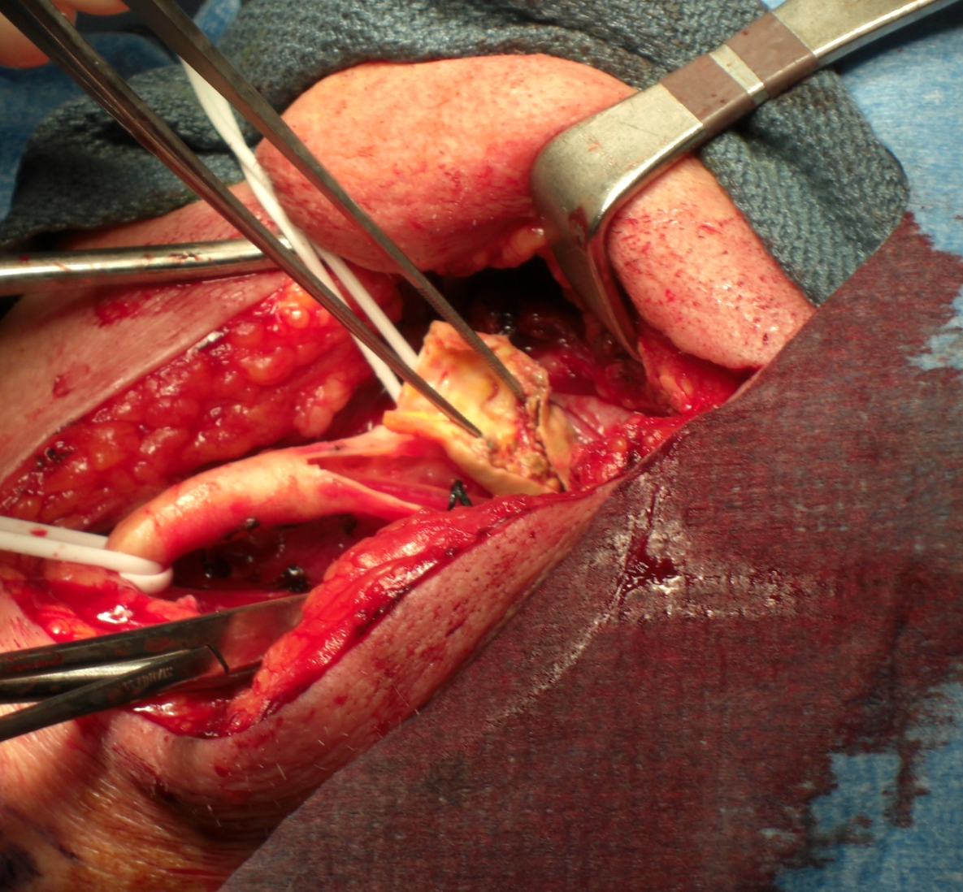
Carotid Endarectomy
The photo to the right shows a portion of plaque being removed during Carotid Endarectomy.

Slide 54
Carotid Endarectomy
Indications
Contraindications
Carotid Stenosis greater than 70% whether the patient is symptomatic or not.
Symptomatic patients especially those with a stenosis greater than 50% and/or ulcerations
Patients with a stenosis greater than 50% if the opposite side also is obstructed.
Total occlusion of the artery
Location of plaque is too high to remove
Other co-morbidities that would make surgery too risky i.e. critical ejection fraction.

Slide 55
Carotid Endarectomy
Complications:
TIA or Stroke
Cranial Nerve Injury
  Facial (VII), Hypoglossal (XII), Vagus (X)
  Injury can result in vocal cord paralysis
Infection of surgical site
Hematoma of surgical site
Restenosis of artery
Death

Slide 56
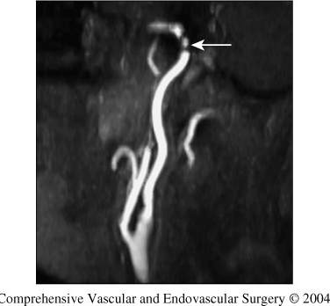
Carotid Endarectomy
Diagnostic Tests:
Duplex Ultrasound
Magnetic Resonance Angiography (MRA)
Contrast Angiography
Some patients may benefit from Magnetic Resonance Imaging (MRI) as well

Slide 57
Carotid Endarectomy
Nursing Considerations

Slide 58
Carotid Endarectomy
Pre-operative:
Patient Interview:
  Assess patient’s medical history, neurological status, and learning needs.
    History of TIA, Stroke, other co-morbidities
    Physical exam
    Vitals, Cardiac Clearance
    Medications (blood thinners)
    Questions regarding procedure and recovery
Site Marking

Slide 59
Carotid Endarectomy
Pre-Operative
  Room Set-up
    Patient films (MRA, CT)
    Patient positioning supplies
    Intraoperative Electroencephalogram (EEG), if requested, to monitor cerebral blood flow
    Medications to be used on the field (Heparin, Lidocaine, antibiotic irrigation)
    Instrumentation and Supplies (Javid Shunt, PTFE patch)
    Anesthesiologist requests (Art line, Medications, BIS monitor)

Slide 60
Carotid Endarectomy
Intra-Operative
Patient positioning:
  Supine position
  The patient’s arms are padded and tucked to his/her sides. Be careful to pad all bony prominences and keep hands in normal position to prevent nerve damage. Be aware of IV and Arterial line positioning.
  A shoulder roll is then placed behind the patient and head turned to expose affected side.
  A “doughnut” pillow can be used if additional extension of the neck is needed.

Slide 61
Carotid Endarectomy
Intra-Operative
Shave surgical area if necessary with approved clippers.
Prep affect side with prep of surgeon’s choice. Be careful not to run the area to prevent risk of causing emboli.
Usually no Foley catheter placed
Bilateral calf high sequential compression devices

Slide 62
Carotid Endarectomy
Pick List:
Instruments:
Minor Vascular Tray
Javid Shunt Clamps (if shunting)
Supplies:
Thyroid Sheet
Vessel loops, hemoclips, peanuts, pledgets, #11 blade, suture boots
Javid shunt (if shunting)
Carotid patch (if patch angioplasty)
Silk ties, vascular and closing suture

Slide 63
Carotid Endarectomy
Overview of Procedure

Slide 64
Carotid Endarectomy
Operative Procedure:
A vertical incision is made over the carotid bifurcation and a self-retaining retractor is placed to expose the area.
Either Metz or Tenotomy scissors are used to dissect the soft tissue exposing the carotid vessels. Unnecessary blood vessels are tied and cut along the way.
Should the surgeon wish to inject the carotid body he/she would do so now with 1% lidocaine. Vessel loops are placed around the common, external and internal carotid arteries.
The patient is then heparinized. Usual dosage is 100u per kilogram of patient weight.

Slide 65
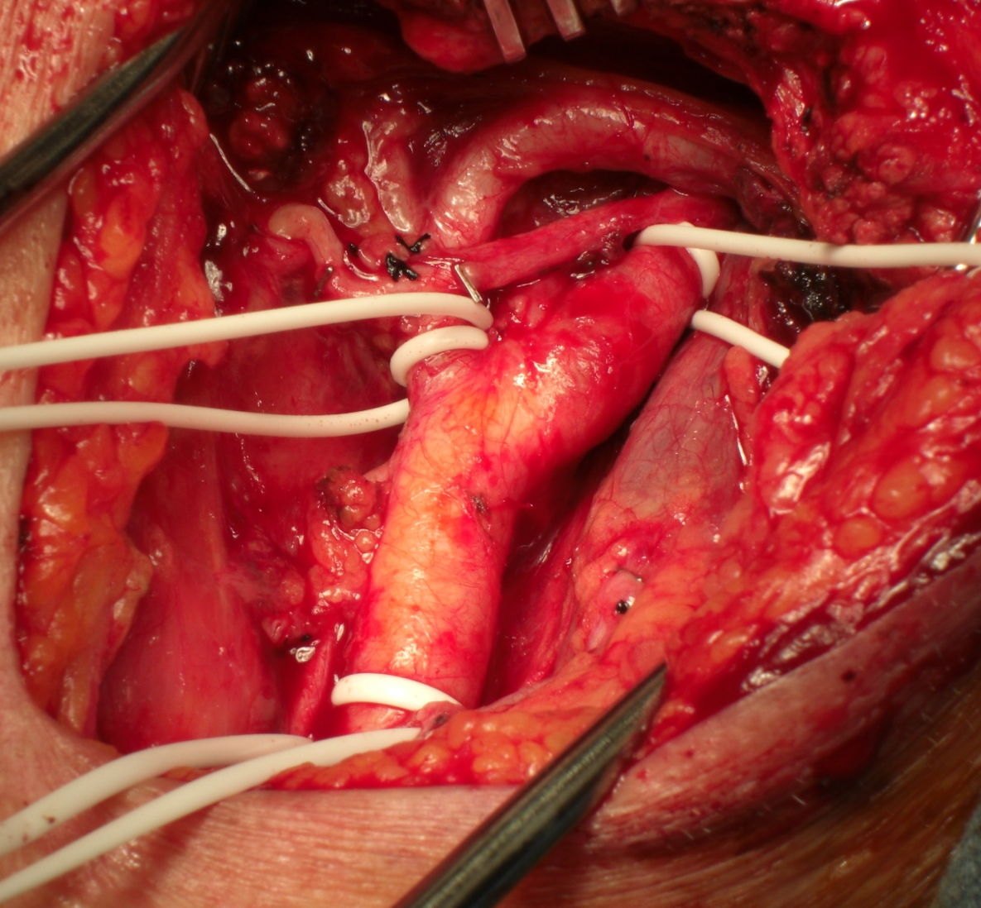
Carotid Endarectomy
This is the Left carotid bifurcation after dissection and vessel loops are placed.
Upper left: external carotid
Upper right: Internal
Bottom: Common

Slide 66
Carotid Endarectomy
Operative Procedure: (cont)
After approximately 3 minutes, the 3 carotid arteries are clamped with the vessel loops.
Using an #11 blade, an incision is made over the stenotic area. Potts angled scissors are used to further lengthen the incision to expose the entire stenotic area. If the surgeon is using a Javid shunt device, it would be placed during this step.
The shunt tubing is placed inside the common and internal carotid and is held in place by a shunt clamp.

Slide 67
Carotid Endarectomy
Operative Procedure: (cont)
Using a blunt elevator, the plaque is dissected away and removed from the artery wall. A 20cc syringe with an 18g IV cannula filled with heparinized saline is used to irrigate the area. Myringotomy forceps may be used to remove any additional threads of plaque so there is no debris that could cause embolism.
After the surgeon is satisfied with the dissection of plaque, he/she prepares to close the arteriotomy with or without a PTFE patch using small prolene double-armed suture (usually 6-0).

Slide 68
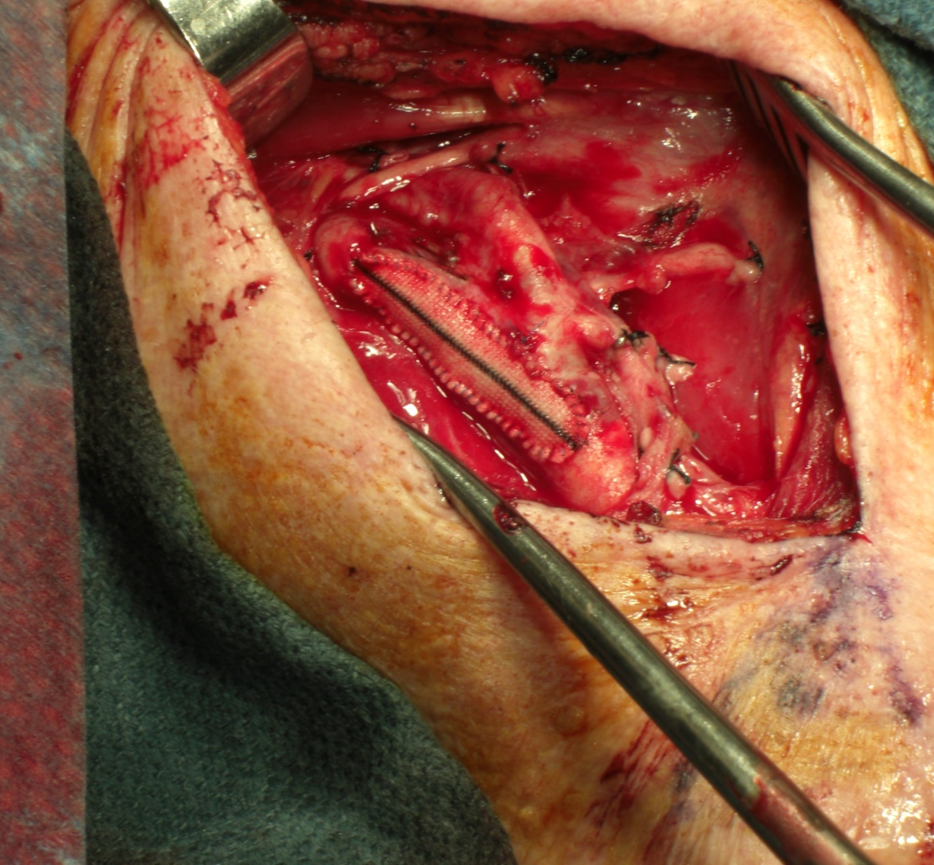
Carotid Endarectomy
This is a completed Patch Angioplasty.

Slide 69
Carotid Endarectomy
Operative Procedure: (cont)
Before the closure is completed, if a shunt was used it is now removed and blood flow temporary restored to flush away any remaining loose plaque. Closure is completed and clamps removed.
Clamps on the external, then common and finally internal carotid arteries are removed to prevent plaque going into the internal carotid.
Additional sutures with or without pledgets (small pieces of felt) may be used to control any bleeders through the closure.

Slide 70
Carotid Endarectomy
Operative Procedure: (cont)
Once hemostasis is secured, the rest of the wound is closed with an absorbable suture such as Vicryl.
A drain may be placed if surgeon preference
Dressings are then applied to the surgical wound.

Slide 71
Carotid Endarectomy
Post-Operative Nursing Considerations

Slide 72
Carotid Endarectomy
Post-Operative:
PACU:
  Monitor neurological status of the patient
    Numbness
    Facial Droop
    Unilateral weakness or paralysis
    Assess for any difficulty with speaking which could indicate a cerebral nerve injury
Notes:
In addition to standard monitoring (VS, temp)

Slide 73
Carotid Endarectomy
Post-Operative: (cont)
PACU:
  Monitor vitals keeping blood pressure within 20mm Hg of baseline
  Assess incision for signs of swelling or excessive bleeding
  Discharge patient to intensive care unit for overnight monitoring

Slide 74
Carotid Endarectomy
Follow-Up:
Patients are usually discharged home within 1-2 days after surgery with appropriate discharge instructions from surgeon.
  These will include follow-up appointment instructions, prescribed medications and usage directions, and any deemed lifestyle changes such as smoking cessation.
  3 month, 6 month and then annual follow-up scans may be performed to ensure continued patency of vessels.

Slide 75
Carotid Endarectomy
Long-Term Considerations:
Patients may need to take life-long blood thinners such as aspirin as well as other medications.
Patients may have restenosis of the vessels and may someday require additional intervention especially if needed lifestyle changes do not occur.
Patients may still be at risk of embolism and stroke after hospital discharge and should report any neurological changes to his/her physician immediately.

Slide 76
Carotid Endarectomy
References
ANCC (2006). Cardiac Vascular Nursing, 2nd ed., pp.307-309.Silver Spring: ANCC
Hallett J, Mills JL, Earnshaw JJ, and Reekers, JA (2005). Comprehensive Vascular and Endovascular Surgery, 2nd ed., pp. 547-567. Philadelphia: Mobsy
Moore KL, Dalley AF (2006). Clinically Oriented Anatomy 5th ed., pp1071. Philadelphia: Lippincott
Rothrock JC (2006). Alexander’s Care of the Patient in Surgery 12th ed., pp. 1106-1109. St. Louis: Elsevier

